Slide 1
T3/Tutorials: Data Submission
Uploading germplasm information
https://triticeaetoolbox.org/

Slide 2
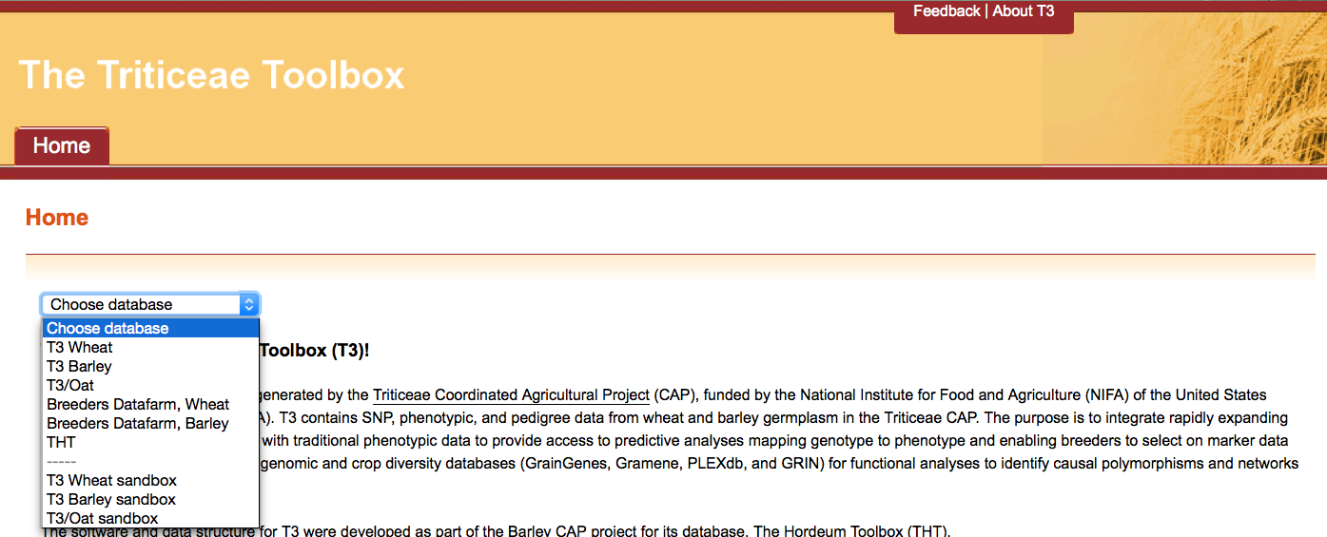
The Triticeae Toolbox (T3)
Each of the T3 databases can be reached from the T3 homepage: https://triticeaetoolbox.org
T3/Wheat will be used for demonstration purposes but these instructions are applicable to each instance of T3

Slide 3
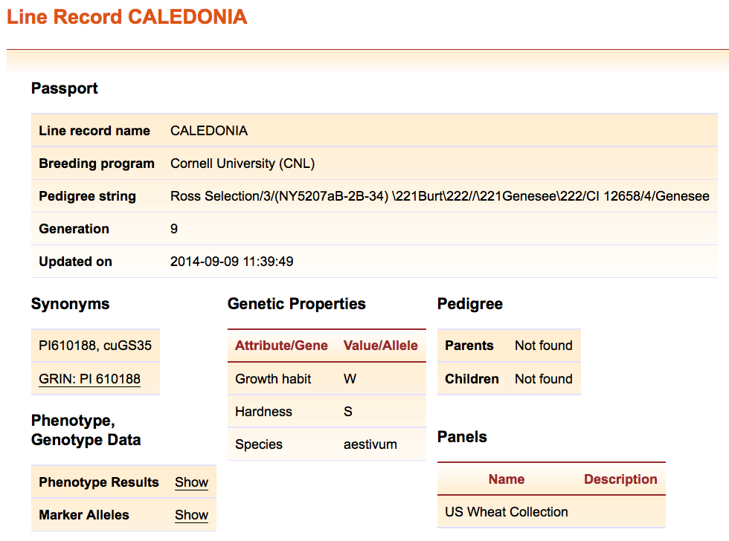
T3 line records
The line name is the unique identifier for a line record
Required information: Line name, breeding program, filial generation and species
Loading line information is the first step towards uploading phenotype and genotype data to T3

Slide 4
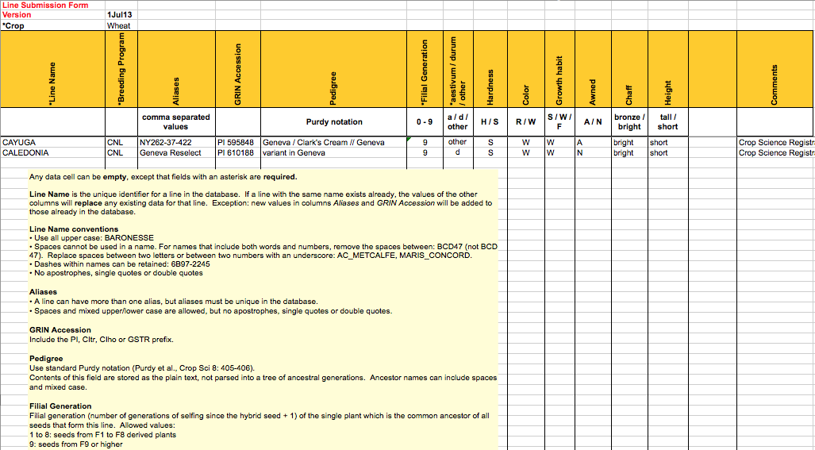
T3 line submission form
Line information is submitted to T3 using a crop-specific line submission form
The template can be used to add new lines or to update the information held about existing T3 lines

Slide 5
Uploading germplasm information:
Outline
Line nomenclature
Search existing line records in T3
The line submission template
Downloading the template
Completing the template
Uploading the template
Test-loading the template
Submitting the template

Slide 6
Section 1: Line nomenclature
Rule | Example
1. Capital letters only | Leggett è LEGGETT
2. No spaces: replace spaces between two letters with an underscore “_” and remove spaces that separate a letter from a number. | AC Assiniboia è AC_ASSINIBOIA
 | Clintland 60 è CLINTLAND60
3. Characters are restricted to letters, numbers, underscores and dashes: remove special characters or replace with an underscore “_” if separation is required to maintain meaning. | Dippes Überwinder è DIPPES_UBERWINDER
 | 24-30-B/69 è 24-30-B69
4. Line names must be unique: a pipe “|” and the GRIN accession of the line can be used to differentiate lines with the same common name. | RED_ALGERIAN|CIAV4635
Format line names according to the rules outlined above
Now use the formatted list to search existing T3 line records

Slide 7
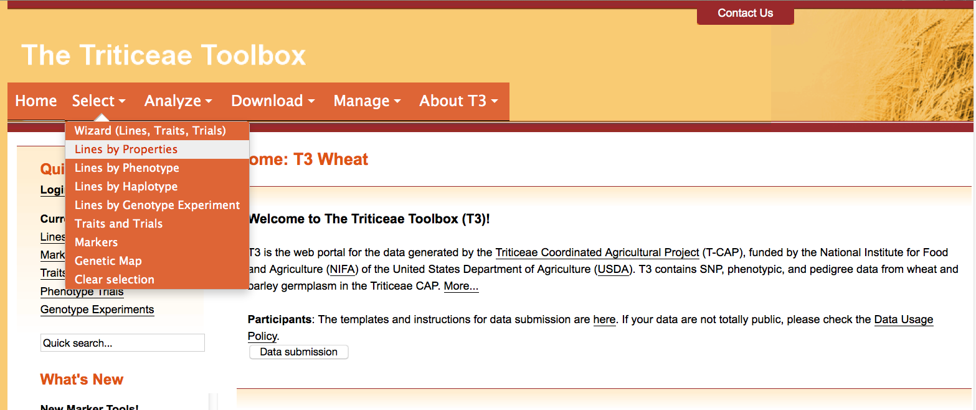
Section 2: Searching existing line records in T3
Navigate to the T3 database homepage of your choice
e.g. https://triticeaetoolbox.org/wheat/
Choose the Select menu > Lines by Properties

Slide 8
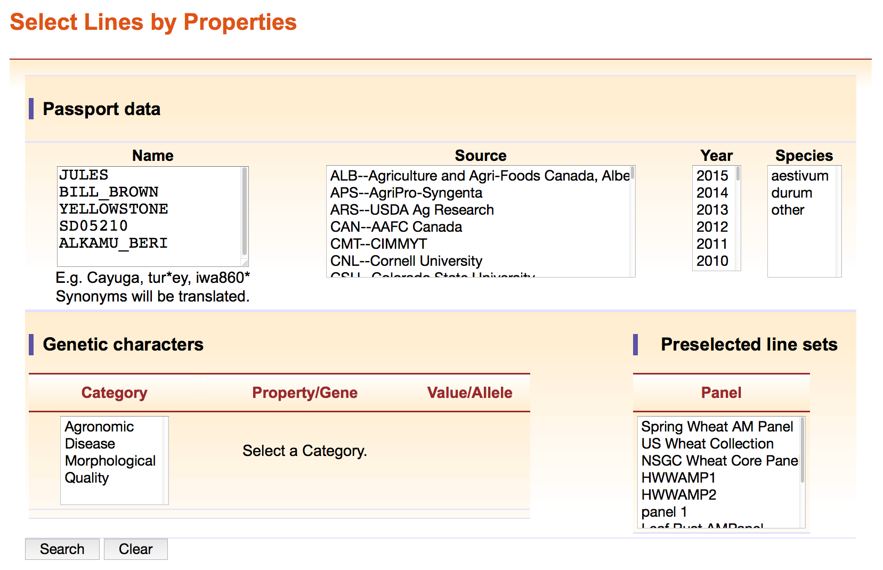
Section 2: Searching existing line records in T3
Copy and paste (or type) a formatted list of line names into the “Name” box and click “Search”

Slide 9
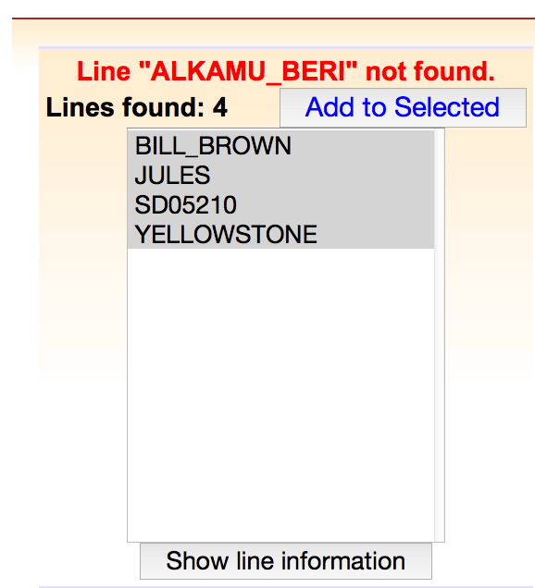
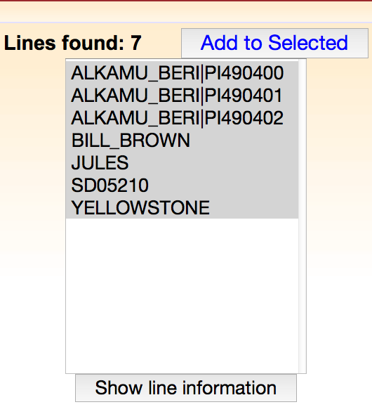
Section 2: Searching existing line records in T3
Line names that are already in the database will appear in the results box
Click “Show line information” to view the existing information for these T3 lines
Please contact the curator if you have any hesitations about combining your data with that of an existing T3 line of the same name
An asterisk “*” can be used as a wildcard to find similar names
e.g. ALKAMU_BERI*
Line aliases will be converted to T3 primary names in the results box
Line names that are not in T3 should be added using the line submission template

Slide 10
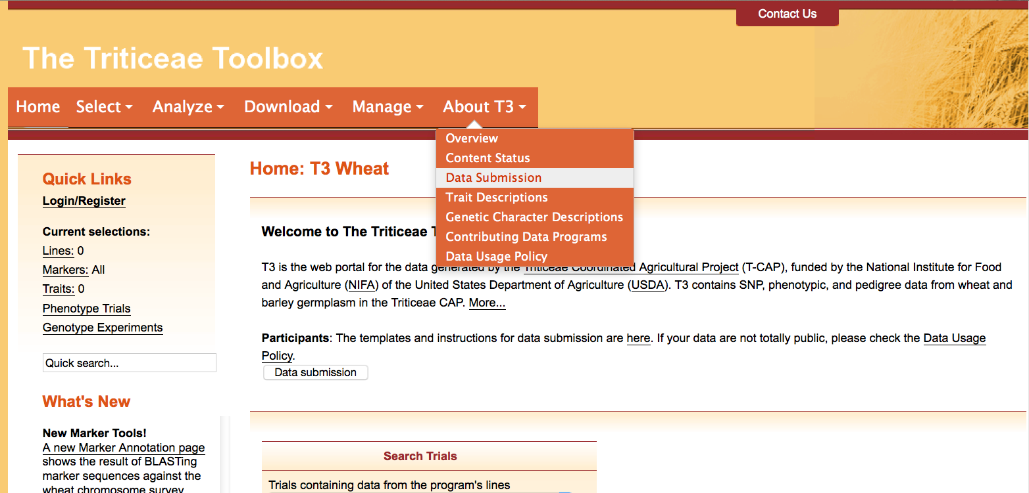
Section 3.1: Downloading the template
Choose the About T3 menu > Data Submission

Slide 11
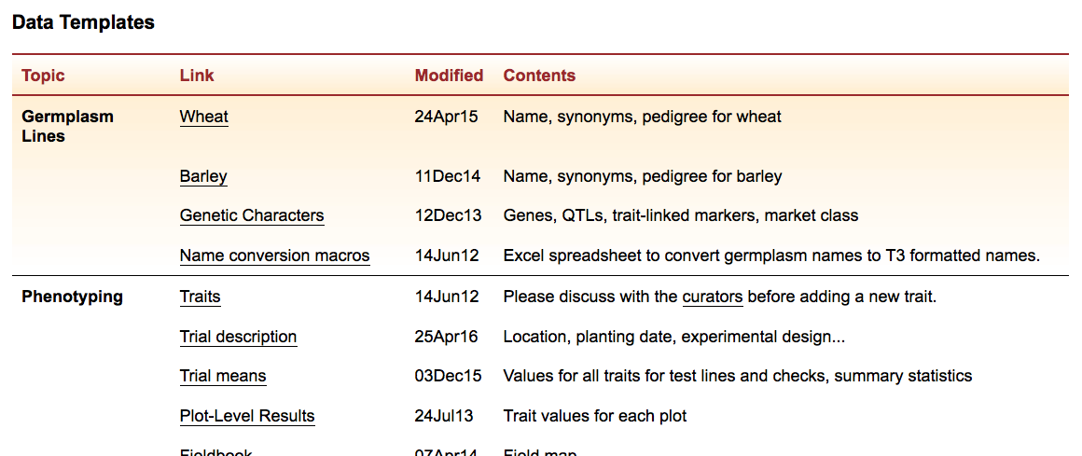
Section 3.1: Downloading the template
Select the crop-specific line submission template from the list to download the Excel template

Slide 12
Section 3.2: Completing the template
The notes section contains most of the information required to fill out the line submission template, apart from the:
Breeding program codes
Line properties
This information can be found under the “About T3” menu
Line properties

Slide 13
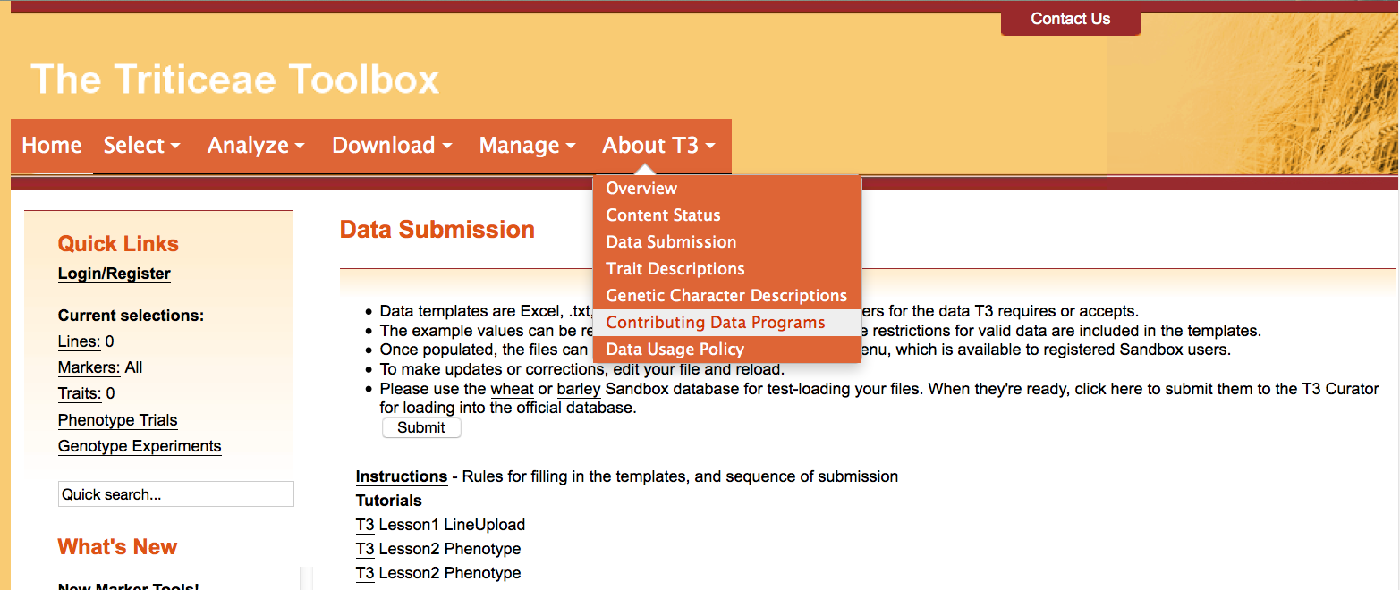
Section 3.2: Completing the template
To find a T3 breeding program code
Choose the About T3 menu > Contributing Data Programs

Slide 14
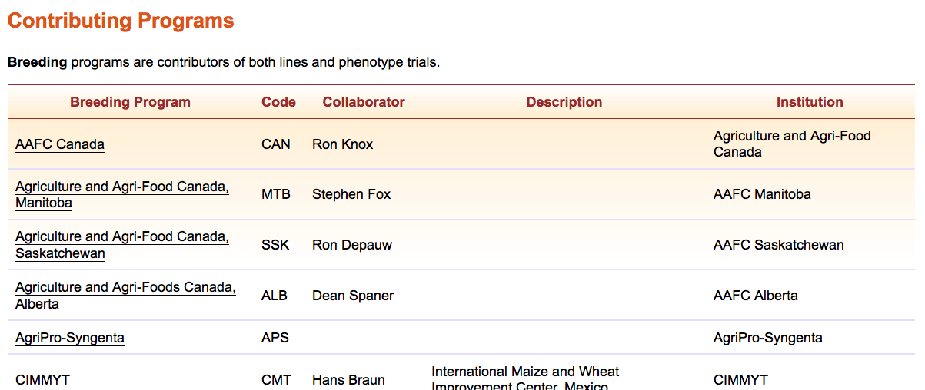
Section 3.2: Completing the template
The breeding program codes can be found in the second column of the table on the Contributing Programs page
Contact the curator if you do not find an appropriate code

Slide 15
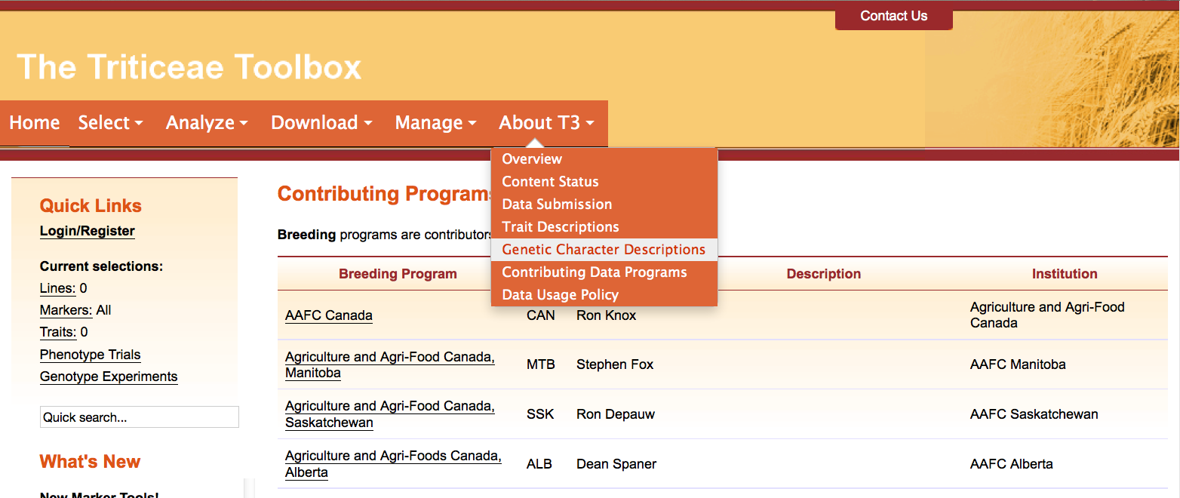
Section 3.2: Completing the template
To find the values for loading additional line properties
Choose the About T3 menu > Genetic Character Descriptions

Slide 16
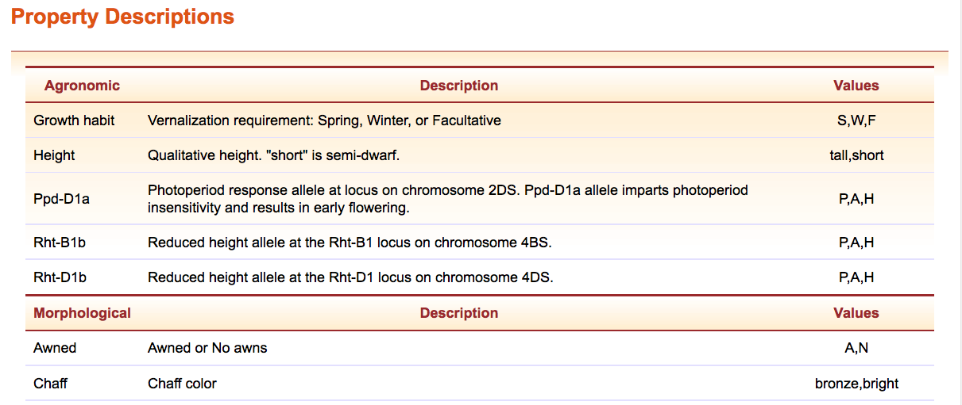
Section 3.2: Completing the template
Use the values in the first column as headings in the template
Use a value from the third column to provide line information
In both cases take care to follow the exact formatting

Slide 17
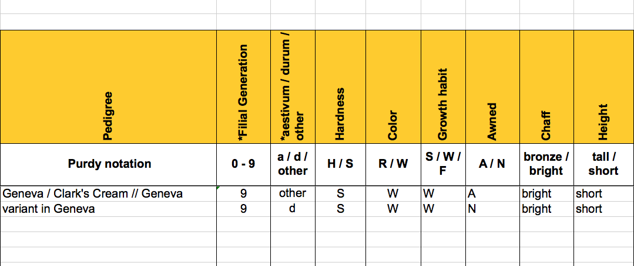
Section 3.2: Completing the template
You can add and remove columns in the highlighted section
Line properties are not required fields and so the corresponding cells can be left blank

Slide 18
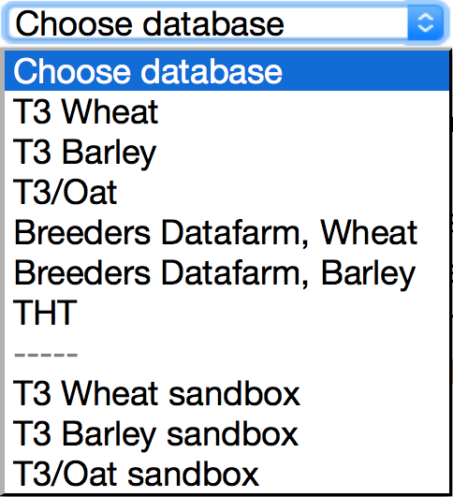
Section 4.1: Test-loading the templates
Each T3 database has a corresponding “sandbox”
Registered users can test-load data in these sandboxes
Data that is successfully uploaded to a sandbox can be submitted to the curator to be uploaded to the related production database
The production databases are the official repositories of T3 data
The sandboxes revert to an exact copy of the production databases each night

Slide 19
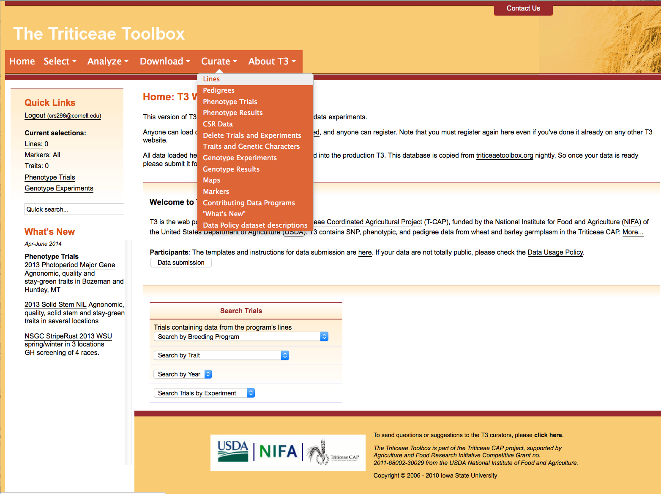
Section 4.1: Test-loading the template
Navigate to the crop-specific T3 sandbox of your choice
e.g. https://t3sandbox.org/t3/sandbox/wheat/
The curation menu will appear once you register and login
Choose the Curate menu > Lines

Slide 20
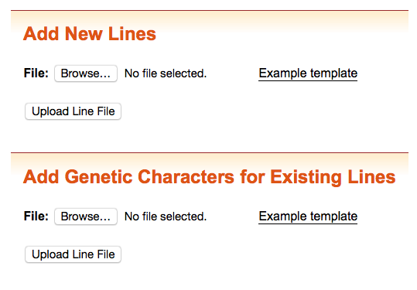
Section 4.1: Test-loading the template
Select the completed line submission template to test-load it in the sandbox
An additional template allows you to add genetic characters/line properties to existing T3 lines
The only required field is the T3 line name
The template can also be downloaded from the “Data Submission” page

Slide 21
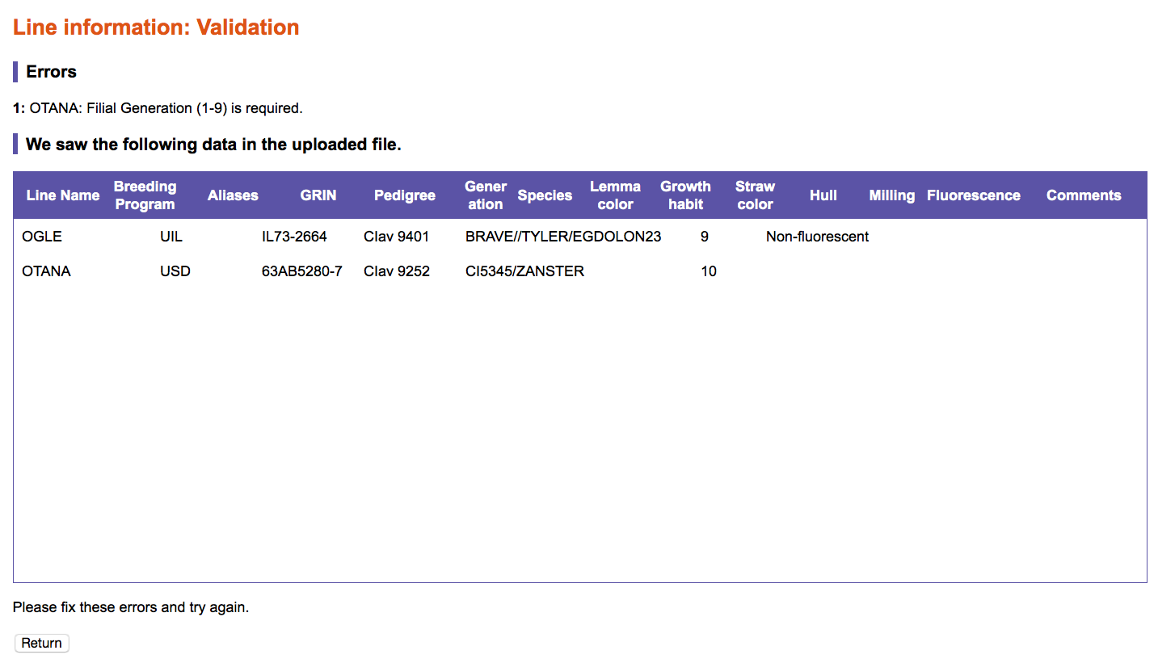
Section 4.1: Test-loading the template
T3 will highlight illegal entries in your uploaded line file
e.g. Filial generation cannot exceed 9
The window shows how T3 has read the upload file. Please take the time to validate that your data appears there correctly.

Slide 22
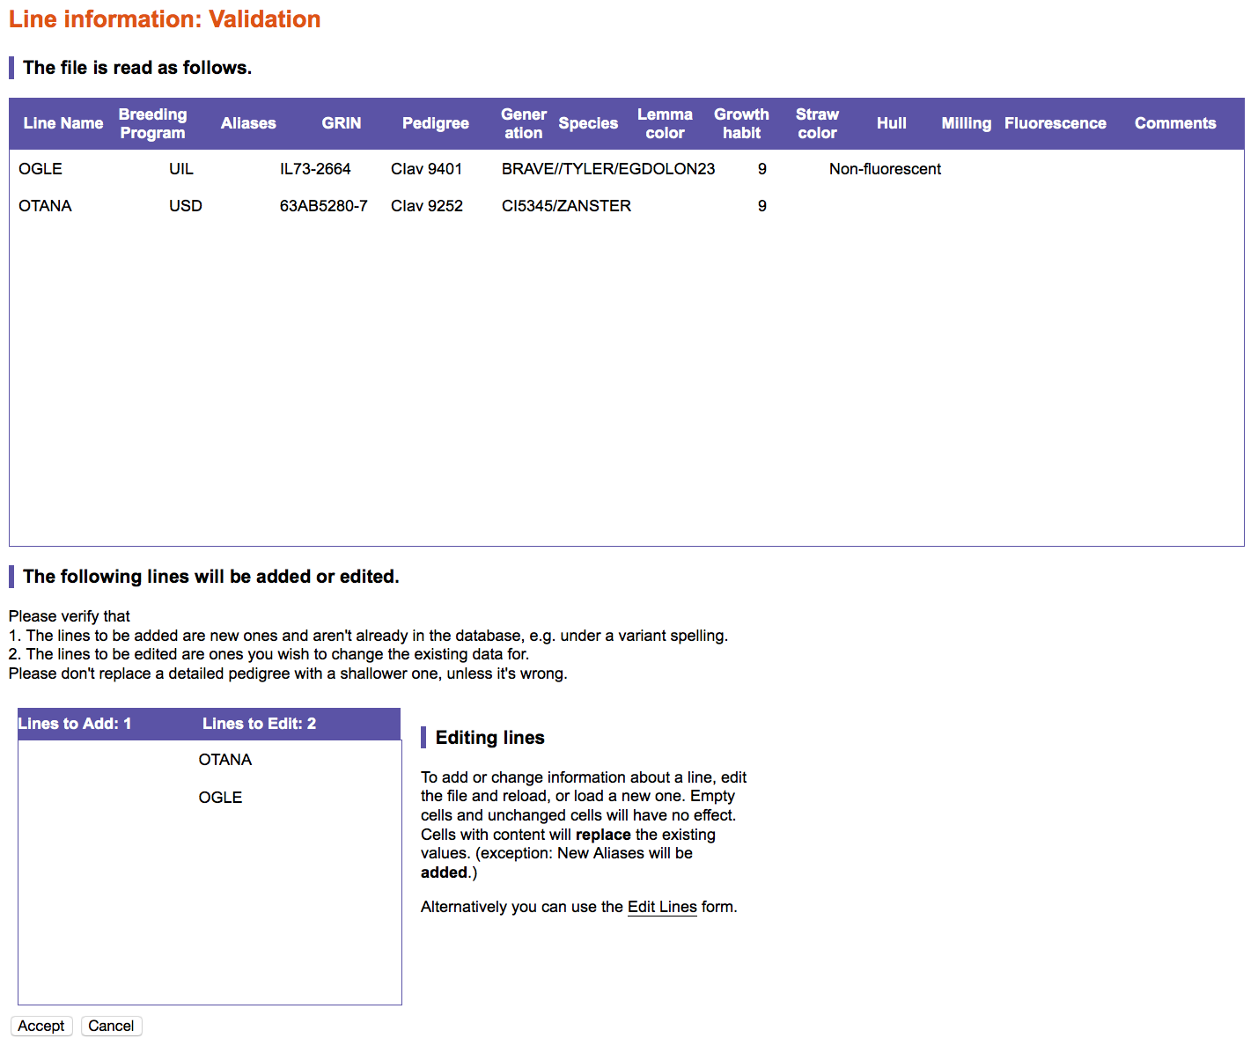
Section 4.1: Test-loading the template
A second box will appear when there are no illegal entries in the uploaded document
The lower box separates the uploaded lines into new lines and existing T3 lines
Don’t forget to “Accept” the upload if the information is correct

Slide 23
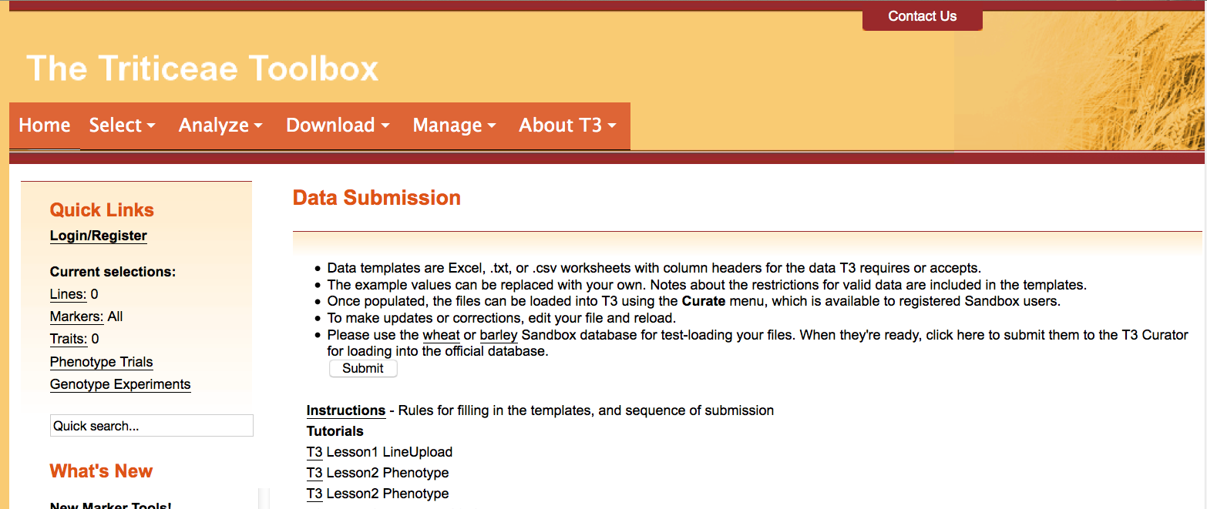
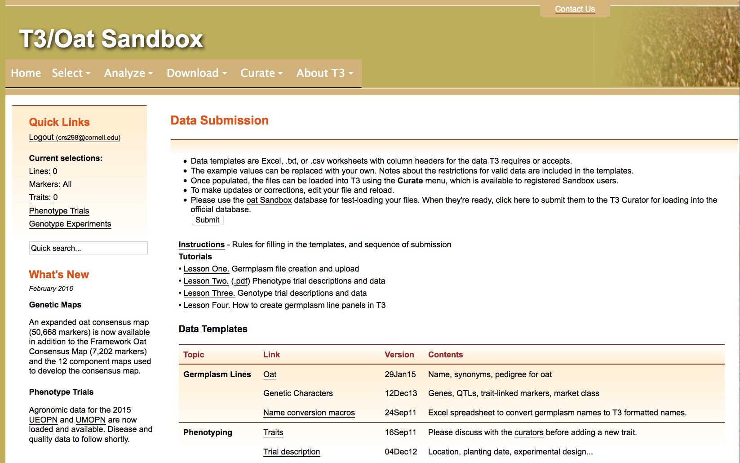
Section 4.1: Submitting the template
Finally, submit the document to the curator for upload to T3
Login and then navigate to the Data Submission page
Click the “Submit” button

Slide 24
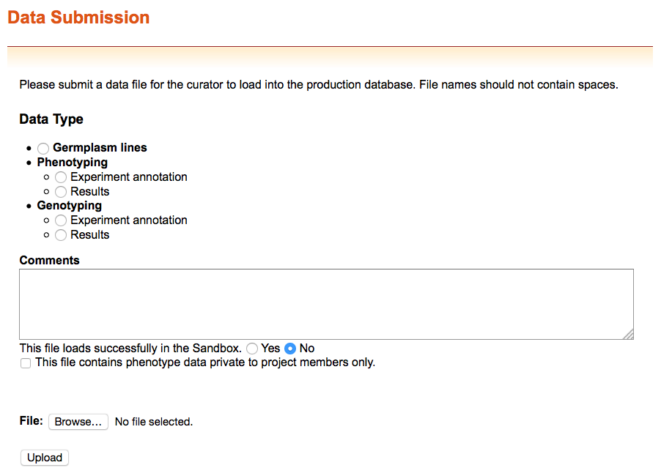
Section 4.1: Submitting the template
You can submit files that do not successfully upload to the sandbox to receive help from the curator

Slide 25
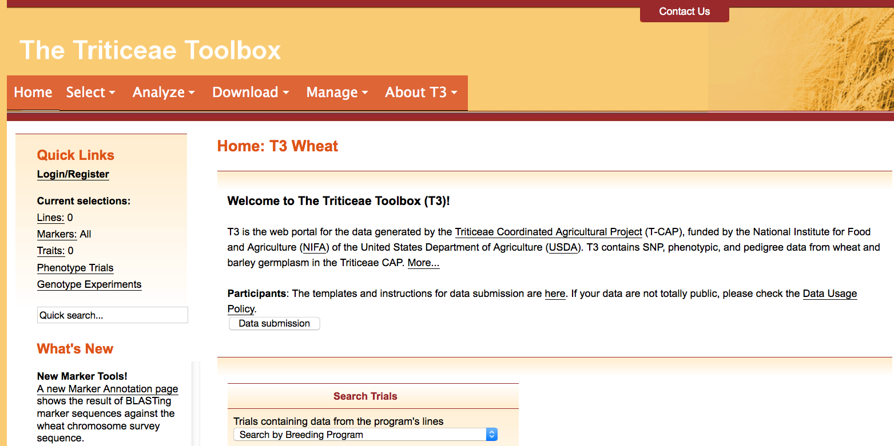
Contact Us
Please contact us if you need help using T3

